Slide 1



Velocity Future Cities
March, 2025
EVera
Increase the percentage of carbon-free energy in the grid
Anna Kudiakova
Diana Shakhova
MaSc, SYDE
MaSc, SYDE

Slide 2
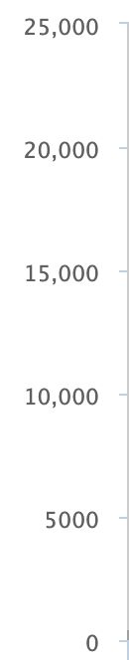
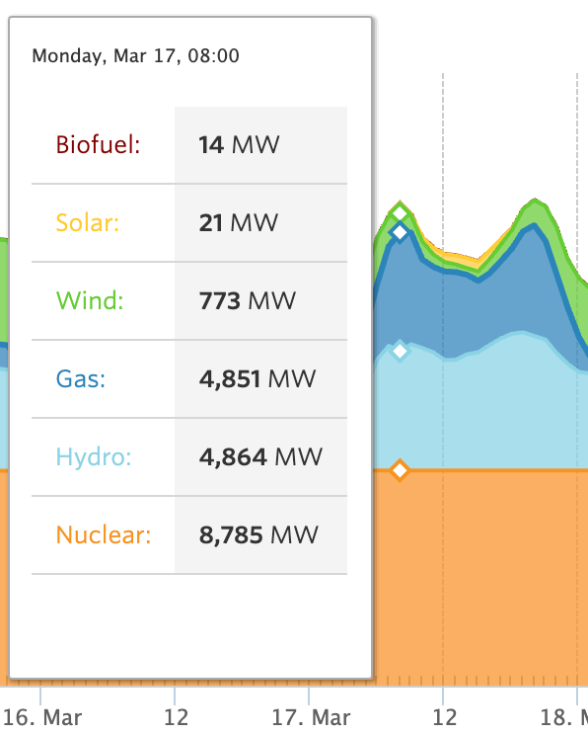

Ontario Electricity Demand
Source: IESO
25.000 MW
8 AM
6 PM
20.000 MW
15.000 MW
10.000 MW
5.000 MW
16. Mar
12PM
17. Mar
12PM
18. Mar

Slide 3
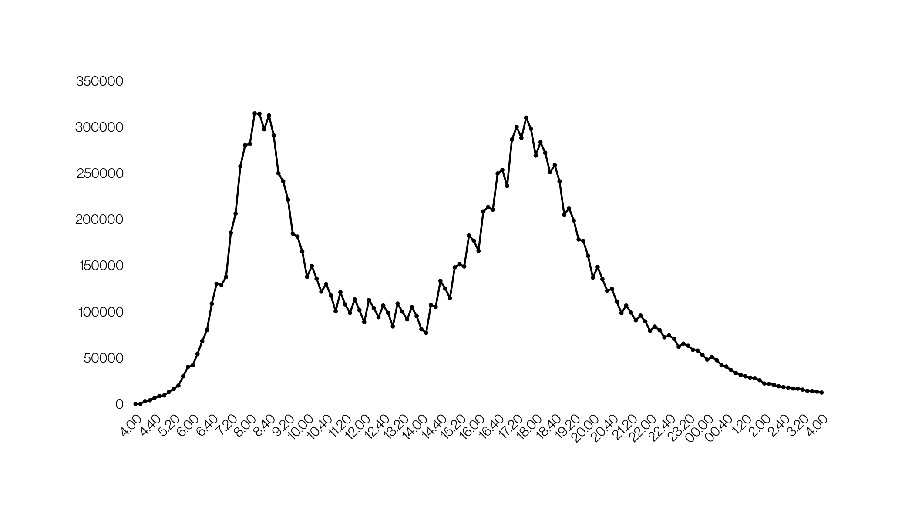

Our Charging Demand Simulation (kWh)
8 am
6 pm
All PVs are EVs
(GTHA)

Slide 4

This will add 11% to the Ontario electricity demand

Slide 5
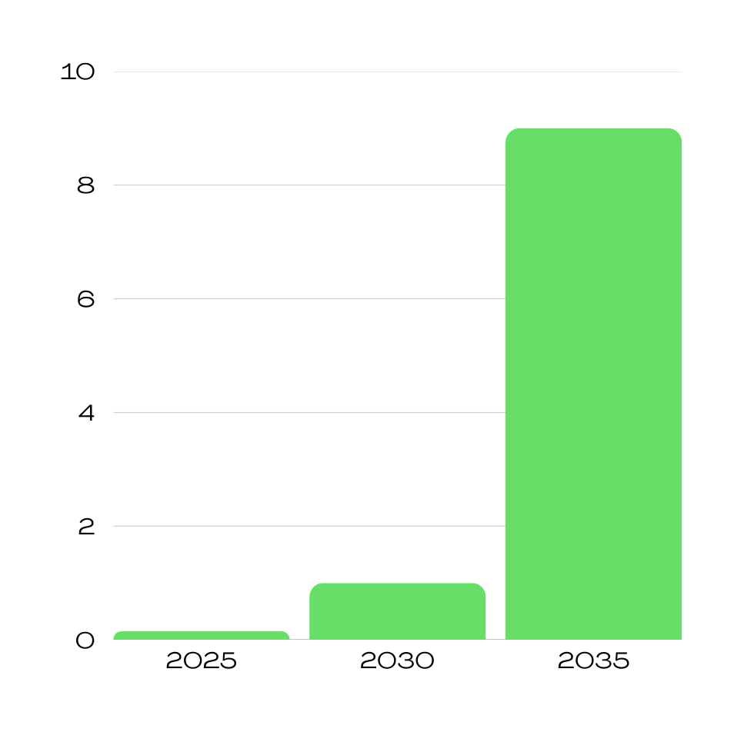
EV Adoption
Page 2
(Ontario)
9.000.000
Milllion, EVs
Currently, EVs make up less than 2% of all conventional vehicles.
1.000.000
150.000

Slide 6

Government Cost Comparison
Single charge for all EVs
$18M Savings
40
Off-Peak (Hydropower)
$36M
30
On-Peak (Natural Gas)
Million, CAD
20
$18M
$3M Savings
10
$0.45M Savings
$6M
$0.9M
$3M
0
$0.45M
2025
150.000 EVs
2030
1.000.000 EVs
2035
9.000.000 EVs

Slide 7
How do we incentivize people to charge off-peak?

Slide 8
plug in when you get home and forget about it.

Slide 9
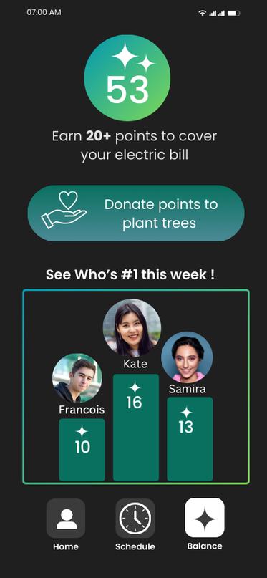

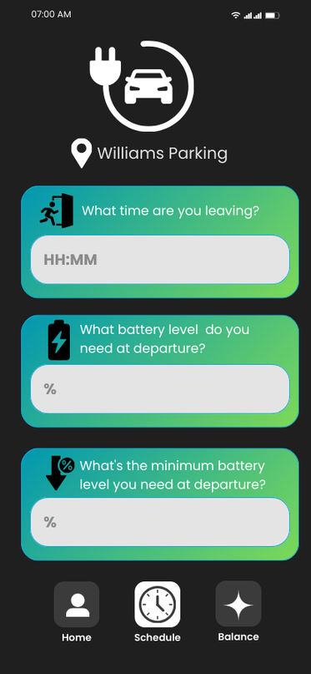
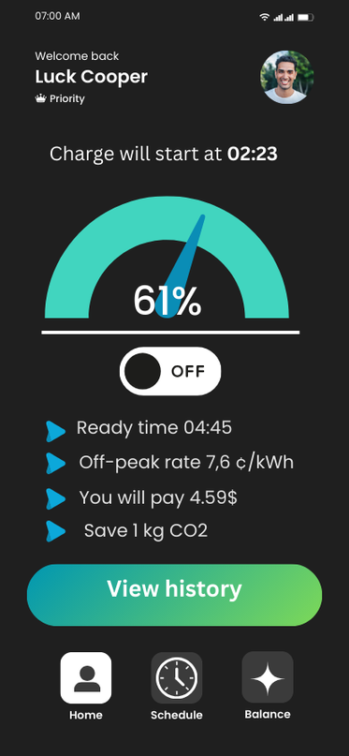


Dashboard
Loyalty points and neighborhood leaderboard!
Smart scheduling
(B2B Subscription)

Slide 10


Subscriptions
CORE
PRO
ENTERPRISE
GRID+
FREE
$ 4.99
$ 99.99
$ 999.99
PER MONTH
/YEAR PER 5 CHARGERS
/ YEAR PER 5 BUSES
Charging history stats and usage patterns
Loyalty points
Advanced energy analytics
Smart charging with IESO Sync integration
Loyalty points
Integration with non smart chargers
Smart scheduling for multiple vehicles
Tax reporting
Fleet-wide energy management
Integration with bi-directional chargers
V2G Smart charging
B2C
B2C
B2B
B2G
CHOOSE PLAN
CHOOSE PLAN
CHOOSE PLAN
CHOOSE PLAN

Slide 11
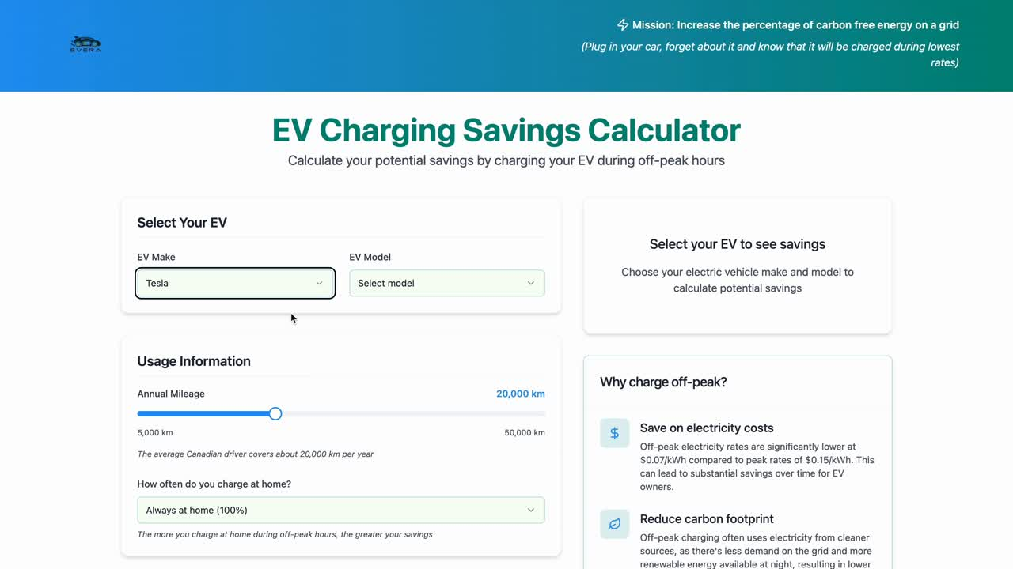

Slide 12
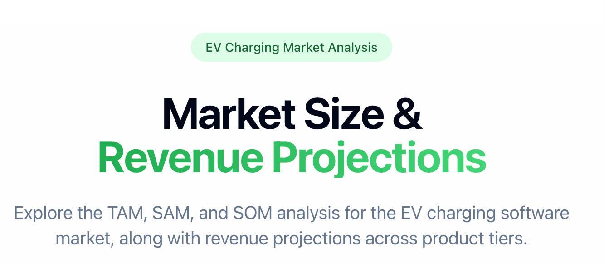
Market Size &
Revenue Projections
Explore the TAM, SAM, and SOM analysis for the EV charging software market, along with revenue projections across product tiers.

Slide 13
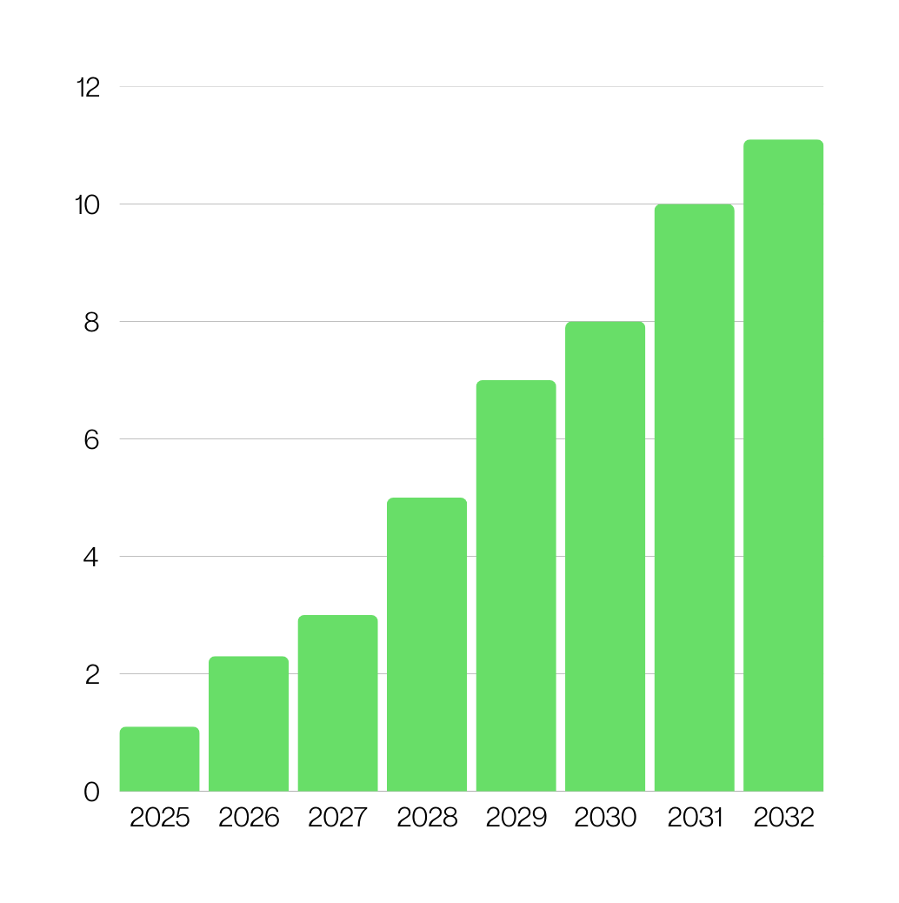

EV charging software market
Page 4
11.1 billion
Market is valued at
2025
1.1 billion
Projected to reach
CAGR 28.9%
Billion, USD
2032
11.1 billion
Growing at a CAGR
2025 - 2032
28.9%
1.1 billion

Slide 14

Market Size Analysis
Breakdown for EV charging software market
$11.1B
Total Addressable Market
Global EV charging software (2032)
$11.1B
$2.1B
Serviceable Addressable Market
95% Compatible EVs x 20% North America
Million, USD
$2.1B
$100.1M
Serviceable Obtainable Market
5% EV users, 3% Business, 2% Government
$100.1M

Slide 15
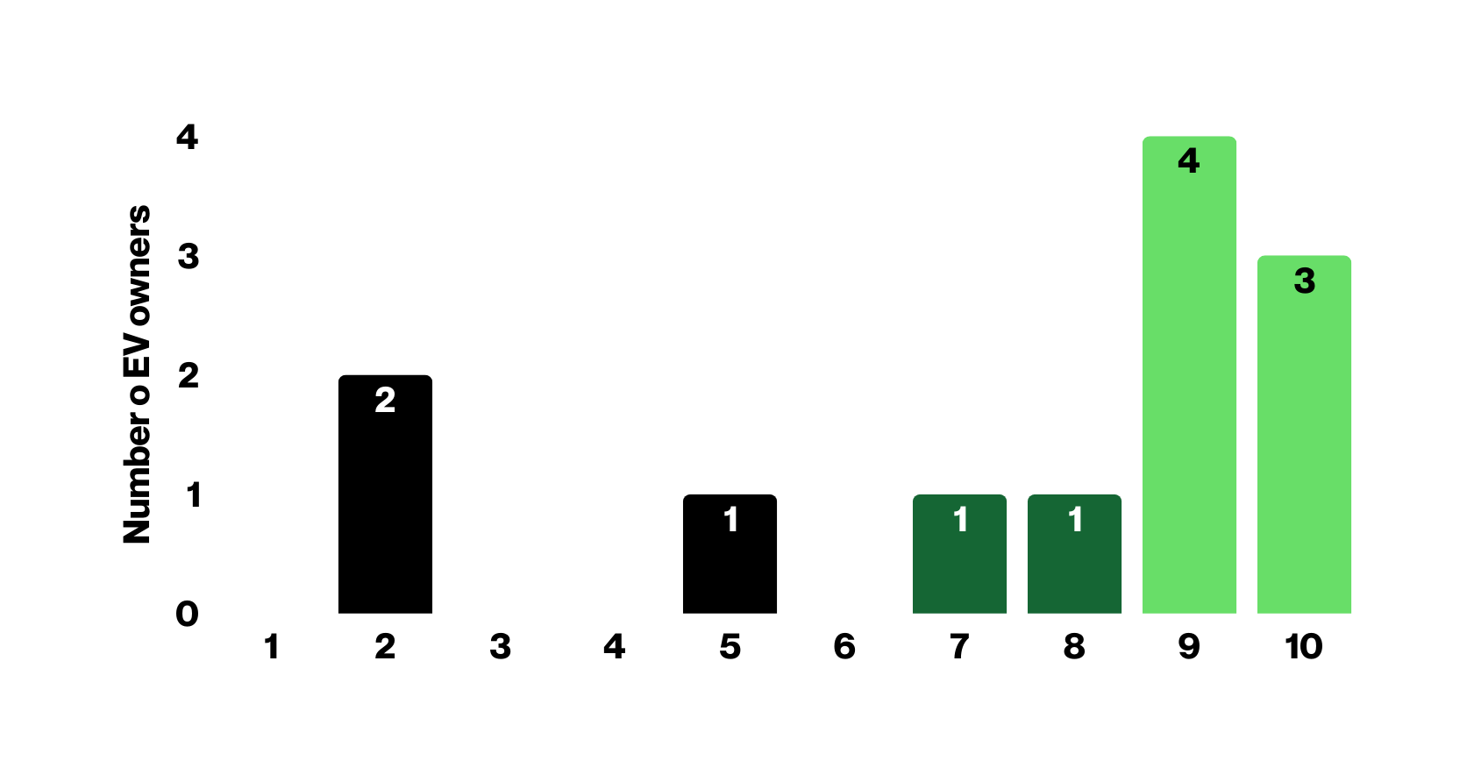



Customer Feedback
Based on initial interviews with 12 EV owners in Ontario
33
Net Promoter Score

Slide 16
your e-car becomes Really green

Slide 17
AND cheap

Slide 18
It’s Your time to plug into the future

